Slide 1


When children are sad
Autism Resource CD v1.0 © 2004
www.askbruno.org
Resource Code RC64

Slide 2
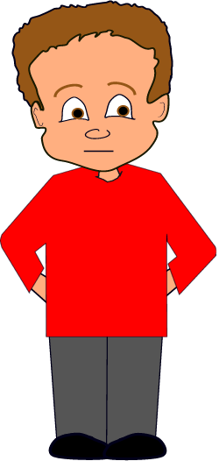
When children are sad
By George Timlin

Slide 3
Sometimes children are sad.

Slide 4
Sometimes when they are sad they cry.

Slide 5
It’s okay when children are sad and they cry.

Slide 6
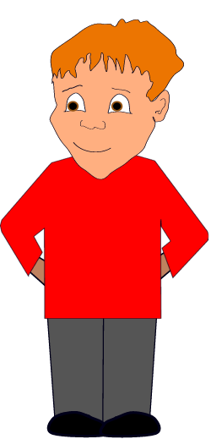
Are you okay? Let’s find the teacher.
Sometimes I help children when they are sad.

Slide 7
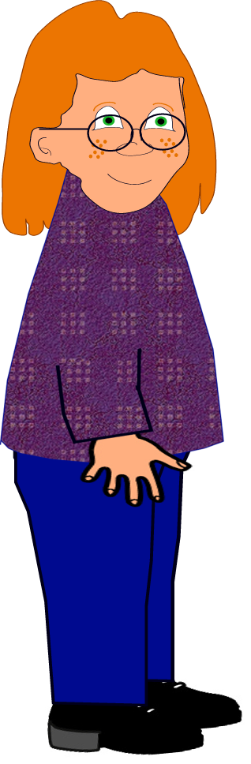
Well done you are being very kind!!
It is a good idea to be kind to children when they are sad.

Slide 8
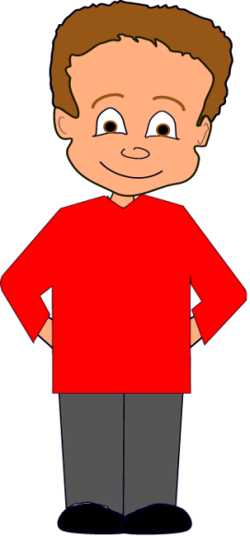
Thank you for being kind.
I will try to be kind to children when they are sad. This makes them happy.

